Slide 1

Mumbai Indians vs. Gujarat Titans: Team Form & Key Players
Explore the latest form and key players shaping the thrilling Mumbai Indians vs. Gujarat Titans showdown. Get insights on winning streaks, star performers, and tactical battles that promise an exciting cricket encounter.

Slide 2
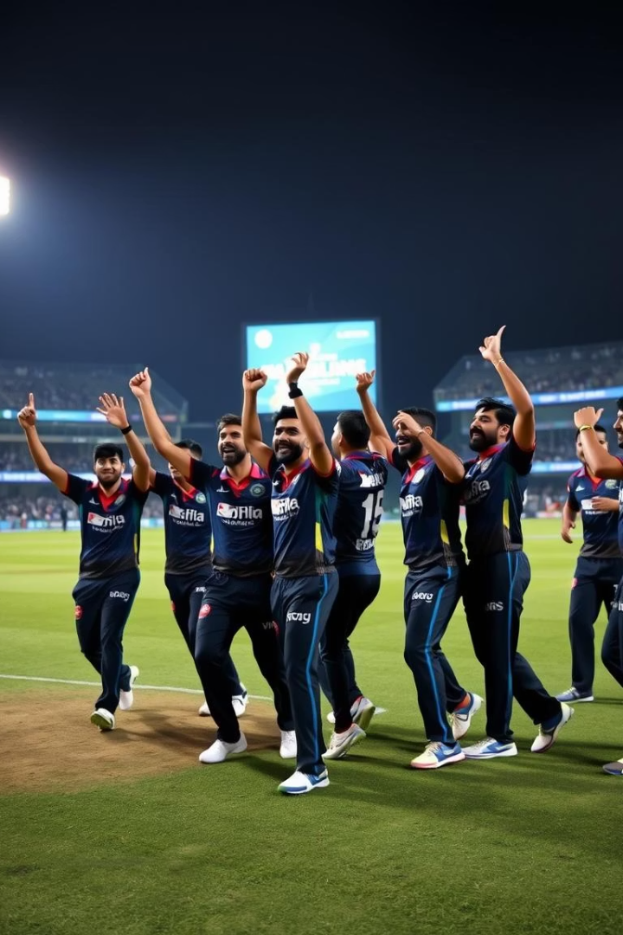
Mumbai Indians: The Winning Streak
Momentum with 6+ Consecutive Wins
Key Moments
Last matches featured nail-biting finishes and commanding wins, showcasing resilience and skill.
MI's cohesive gameplay and strategic tweaks have fueled their winning streak, building strong team confidence.
Recent Scores
Strong batting totals complemented by disciplined bowling, shaping victories and controlling matches.

Slide 3
MI's Batting Powerhouse
Captain Hardik Pandya
Rohit Sharma
Suryakumar Yadav
Ishan Kishan & Tilak Varma
Brings vast experience and stability as an opener, consistently impacting innings early on.
Third highest run-scorer this IPL with over 475 runs, anchoring the middle order effectively.
Leads with aggressive form and sharp decision-making, pivotal in setting the tone at the crease.
Fast scoring batsmen enhancing team firepower with strong strike rates and reliable averages.

Slide 4
MI's Bowling Attack
Jasprit Bumrah
Trent Boult
Excellent economy rate, crucial wicket-taker with consistency in every match.
Leading with 16 wickets; impressive strike rate leveraging swing and pace skills.
All-rounder Support
Bowling Stats
Hardik Pandya and Romario Shepherd provide vital breakthroughs and contain runs both early and in death overs.
Strong team averages in powerplay and death overs underpin tight control over scoring rates.

Slide 5
Gujarat Titans: Strengths and Strategies
Balanced Squad
Fielding Excellence
Strategies
GT combines solid batting depth with disciplined bowling to challenge opponents across formats.
Known for sharp and agile fielders who create pressure and crucial run-outs.
Employ aggressive powerplay tactics and flexible bowling rotations to adapt to match situations.

Slide 6
GT's Key Batsmen
Opening Pair
Middle-order Stability
Finishing Power
Dynamic openers setting brisk starts with high strike rates and boundary hitting.
Experienced players anchoring innings and accelerating scoring in crucial phases.
Key finishers known for managing pressure and executing big hits in final overs.

Slide 7

GT's Bowling Department
Strike Bowlers
Spinner Impact
Lead attack uses pace and swing to take early wickets and break partnerships.
Spin bowlers disrupt batting rhythm, especially in middle overs with smart variations.
All-rounder Contributions
Support bowlers contribute economical spells while adding depth with the bat.

Slide 8




Key Matchups to Watch
Suryakumar Yadav vs. Rashid Khan
Battle of timing and spin mastery; strategic shot selection critical for Yadav.
Hardik Pandya vs. Mohammed Shami
Powerplay clash emphasizing aggressive starts and swing battles.
Player Impact on Outcome
Performance of star players likely to dictate momentum and final result of the match.

